Slide 1



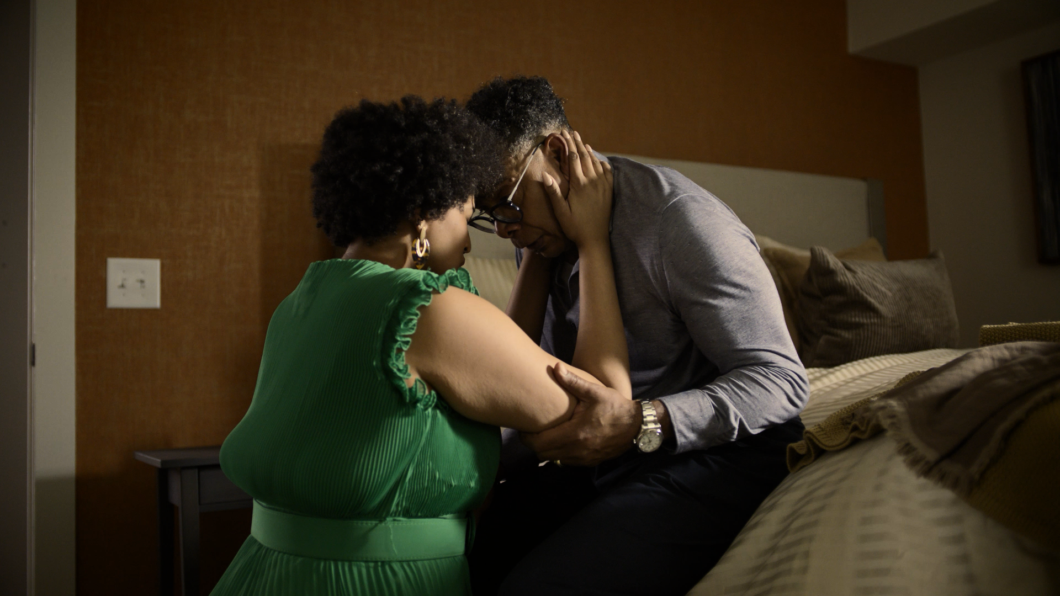
Pause to Heal
Extreme Risk Laws Education
CAMPAIGN OVERVIEW:
Extreme risk laws are life-saving tools available in 22 states and Washington, D.C. that temporarily remove access to a gun for someone in crisis. However, awareness of these tools remains low among the general public.
To combat this low awareness, the Ad Council and Brady came together to launch “Pause to Heal,” piloted in Illinois with the Illinois Department of Public Health. "Pause to Heal" is an innovative and comprehensive public education campaign aimed at raising awareness of extreme risk laws – called "Firearm Restraining Orders" in Illinois—as life-saving intervention tools.
With a successful launch in Illinois, the goal is to expand the "Pause to Heal" campaign to all other states with these laws in place via local partnerships.
CREATIVE:
In any crisis, time is precious. Those in crisis need time to think things over, to seek professional support, and to heal. When a loved one is saying or doing things that suggest they intend to harm themselves or others, having access to a gun can create a dangerous situation. Extreme risk laws hit “pause” during moments of crisis to allow loved ones the time to heal.
The “Pause to Heal” PSAs convey the power of this pause through emotional storytelling to demonstrate the healing potential of extreme risk laws, as well as explanatory messaging to provide more information about this tool. All creative drives to state-specific resources and encourages viewers to learn more.
TARGET AUDIENCE:
Adults in the inner circle of a gun owner in crisis, who may feel like there is no relief in sight.
CAMPAIGN OBJECTIVE:
Raise awareness of extreme risk laws nationally and encourage people to seek out more information and be prepared to initiate one if they see the warning signs in their loved ones who have access to a gun.
CALL TO ACTION:
By temporarily removing a gun, [name of local extreme risk law] gives a person in crisis time to heal. Learn more at [local resource]
75%
of U.S. adults have an extremely or somewhat positive reaction to extreme risk laws (Source: Ad Council Research Institute)
1 Life Saved
from firearm suicide for every 10-20 extreme risk orders issued in Connecticut (Source: Duke Law)
13%
of extreme risk orders issued in California prevented a potential mass shooting (Source: Annals of Internal Medicine)
Questions? Please contact Sammi Fischer (sfischer@adcouncil.org) for more information.

